Slide 1
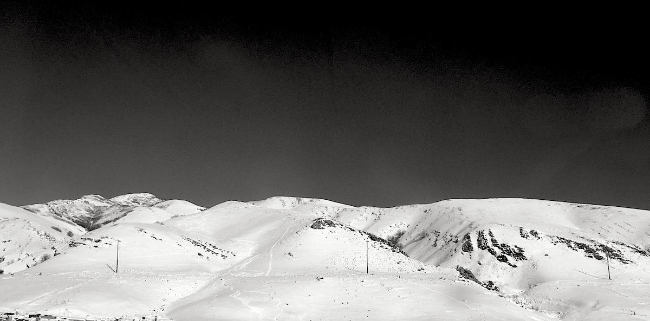
SNP and INDEL discovery
Applied Computational Genomics
https://github.com/quinlan-lab/applied-computational-genomics
Aaron Quinlan
Departments of Human Genetics and Biomedical Informatics
USTAR Center for Genetic Discovery
University of Utah
quinlanlab.org

Slide 2

Goal: find all inherited variants in an individual's diploid genome.

Slide 3
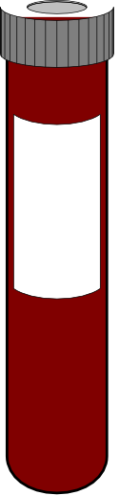
Find inherited genetic variation by sequencing DNA
from millions of cells
A
G
A
G
A
G
A
G
A
G
A
G
A
G
A
G
A
G
x millions

Slide 4
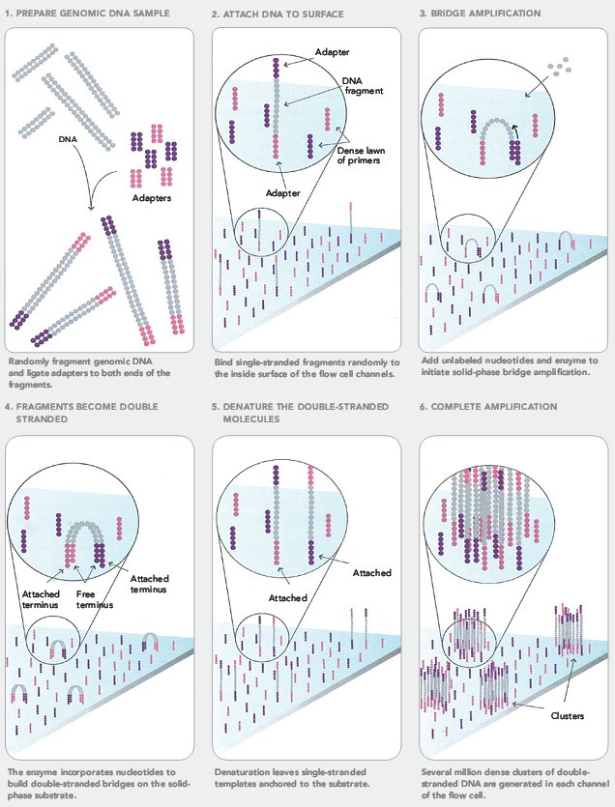
Each DNA cluster is amplified from a single strand from a single haploid chromosome from a single cell.
A
G
@seq1
@seq1
ACCTTCGAACGGCGGGGGGTTACAA
+
!''*((((***+))%%%++).1***
@seq2
TGGAACCGAACGGCCCCGGTTACAT
+
!''*!!!!***+))+++++).1***
@seq3
ACCTTCGAACGGCGGGGGGTTACAA
+
!''*((((***+))%%%++).1***
@seq4
TGGAACCGAACGGCCCCGGTTACAT
+
!''*!!!!***+))+++++).1***
@seq2
A
G
@seq3
@seq4

Slide 5
Scenario 1: An individual is homozygous for the "reference" allele.
♂
♀
Ref
ATCGGGTACCATCCAATCATTACC
♂
ATCGGGTACCATCCAATCATTACC
♀
ATCGGGTACCATCCAATCATTACC

Slide 6
Scenario 1: An individual is homozygous for the "reference" allele.
T
T
@seq1
@seq1
ACCTTCGAACGGCGGGGGGTTACAA
+
!''*((((***+))%%%++).1***
@seq2
TGGAACCGAACGGCCCCGGTTACAT
+
!''*!!!!***+))+++++).1***
@seq3
ACCTTCGAACGGCGGGGGGTTACAA
+
!''*((((***+))%%%++).1***
@seq4
TGGAACCGAACGGCCCCGGTTACAT
+
!''*!!!!***+))+++++).1***
@seq2
T
T
@seq3
@seq4

Slide 7
Scenario 1: An individual is homozygous for the "reference" allele.
Ref
ATCGGGTACCATCCAATCATTACC
GGTACCATCCAAT
T
T
ATCGGGTACCAT
GGGTACCATCCAA
TCGGGTACCATC
T
T
CGGGTACCATCC
GGGTACCATCCA
CGGGTACCATCCA

Slide 8
Scenario 2: An individual is homozygous for an "alternate" allele.
♂
♀
Ref
ATCGGGTACCATCCAATCATTACC
♂
ATCGGGCACCATCCAATCATTACC
♀
ATCGGGCACCATCCAATCATTACC

Slide 9
Scenario 2: An individual is homozygous for an "alternate" allele.
C
C
@seq1
@seq1
ACCTTCGAACGGCGGGGGGTTACAA
+
!''*((((***+))%%%++).1***
@seq2
TGGAACCGAACGGCCCCGGTTACAT
+
!''*!!!!***+))+++++).1***
@seq3
ACCTTCGAACGGCGGGGGGTTACAA
+
!''*((((***+))%%%++).1***
@seq4
TGGAACCGAACGGCCCCGGTTACAT
+
!''*!!!!***+))+++++).1***
@seq2
C
C
@seq3
@seq4

Slide 10
Scenario 2: An individual is homozygous for an "alternate" allele.
Ref
ATCGGGTACCATCCAATCATTACC
GGCACCATCCAAT
C
C
ATCGGGCACCAT
GGGCACCATCCAA
TCGGGCACCATC
C
C
CGGGCACCATCC
GGGCACCATCCA
CGGGCACCATCCA

Slide 11
Scenario 3: An individual is heterozygous for an "alternate" allele.
♂
♀
Ref
ATCGGGTACCATCCAATCATTACC
♂
ATCGGGCACCATCCAATCATTACC
♀
ATCGGGTACCATCCAATCATTACC

Slide 12
Scenario 3: An individual is heterozygous for an "alternate" allele.
C
T
@seq1
@seq1
ACCTTCGAACGGCGGGGGGTTACAA
+
!''*((((***+))%%%++).1***
@seq2
TGGAACCGAACGGCCCCGGTTACAT
+
!''*!!!!***+))+++++).1***
@seq3
ACCTTCGAACGGCGGGGGGTTACAA
+
!''*((((***+))%%%++).1***
@seq4
TGGAACCGAACGGCCCCGGTTACAT
+
!''*!!!!***+))+++++).1***
@seq2
C
T
@seq3
@seq4

Slide 13
Scenario 3: An individual is heterozygous for an "alternate" allele.
Ref
ATCGGGTACCATCCAATCATTACC
GGTACCATCCAAT
C
T
ATCGGGCACCAT
GGGTACCATCCAA
TCGGGCACCATC
C
T
CGGGCACCATCC
GGGCACCATCCA
CGGGTACCATCCA

Slide 14
Why might finding heterozygous variants be harder?

Slide 15
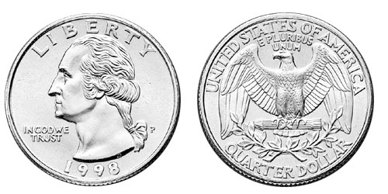
The binomial distribution: adventures in coin flipping
P(heads) = 0.5
P(tails) = 0.5

Slide 16
At heterozygous sites, "heads" is one allele, "tails" is the other!
C
T
P(heads) = 0.5
P(tails) = 0.5
P("ref") = 0.5
P("alt") = 0.5

Slide 17
A challenge in detecting heterozygotes:
Having enough sequencing "depth" to be fairly certain we have sampled both alleles if two alleles are present in the individuals genome

Slide 18
How many heterozygous sites in a typical genome?

Slide 19
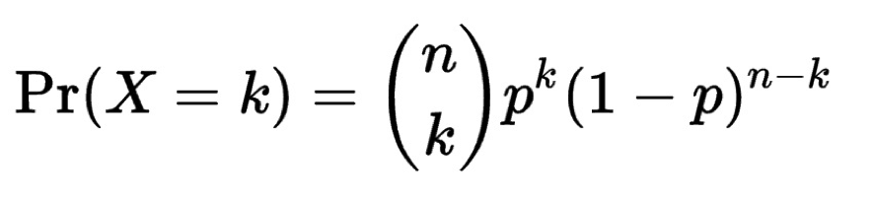
Thinking about allele sampling with the binomial distribution
The binomial distribution with parameters n and p is the discrete probability distribution of the number of successes in a sequence of n independent yes (e.g., "heads" or "reference allele") or no (e.g., "tails", or "alternate allele") experiments, each of which yields success with probability p.
The probability of getting exactly k successes in n trials is given by the probability mass function:
What is the probability of seeing k=1 tails in n=3 flips of a fair coin with the probability of a tail (p) = 0.5?
3 choose 1 = 3; 0.5¹ = 0.5; (1-0.5)⁽³⁻¹⁾ = 0.25. So…. 3*0.5*0.25 = 0.375
In R, the function would be: dbinom(1, size=3, prob=0.5)

Slide 20
What is the distribution of tails (alternate alleles) do we expect to see after 5 tosses (sequence reads)?
Record your result in the following spreadsheet:
https://docs.google.com/spreadsheets/d/1i8sA1KMeYc9UhWTnCg0tLFjCy8x5LlsBITcXrz5La94/edit?usp=sharing

Slide 21
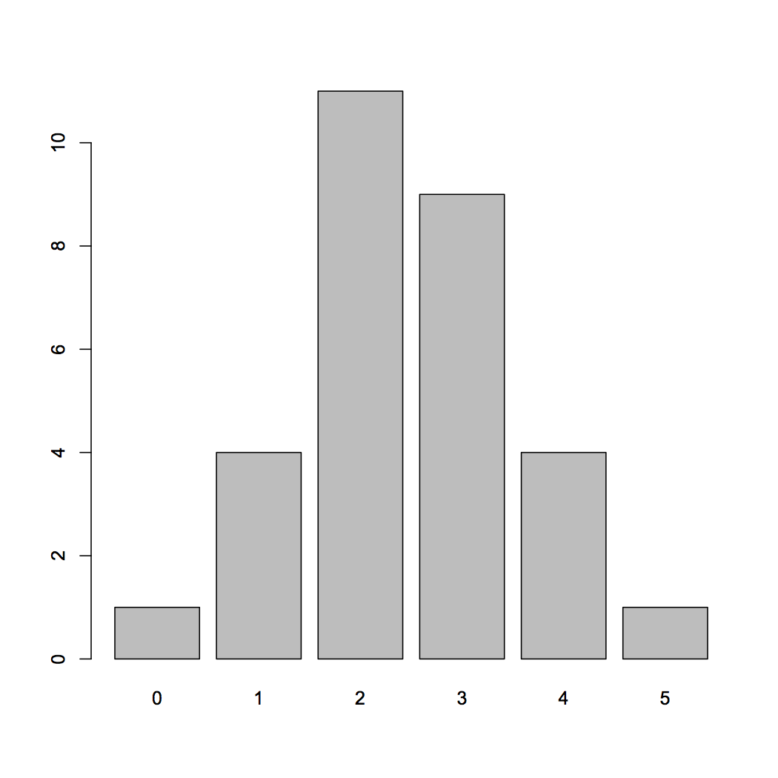
What is the distribution of tails (alternate alleles) do we expect to see after 5 tosses (sequence reads)?
R code:
barplot(table(rbinom(32, 5, 0.5)))
Number of experiments
30 experiments (students tossing coins)
5 tosses each
Probability of Tails
Number of "tails"

Slide 22
What is the distribution of tails (alternate alleles) do we expect to see after 15 tosses (sequence reads)?
Record your result in the following spreadsheet:
https://docs.google.com/spreadsheets/d/1i8sA1KMeYc9UhWTnCg0tLFjCy8x5LlsBITcXrz5La94/edit?usp=sharing

Slide 23
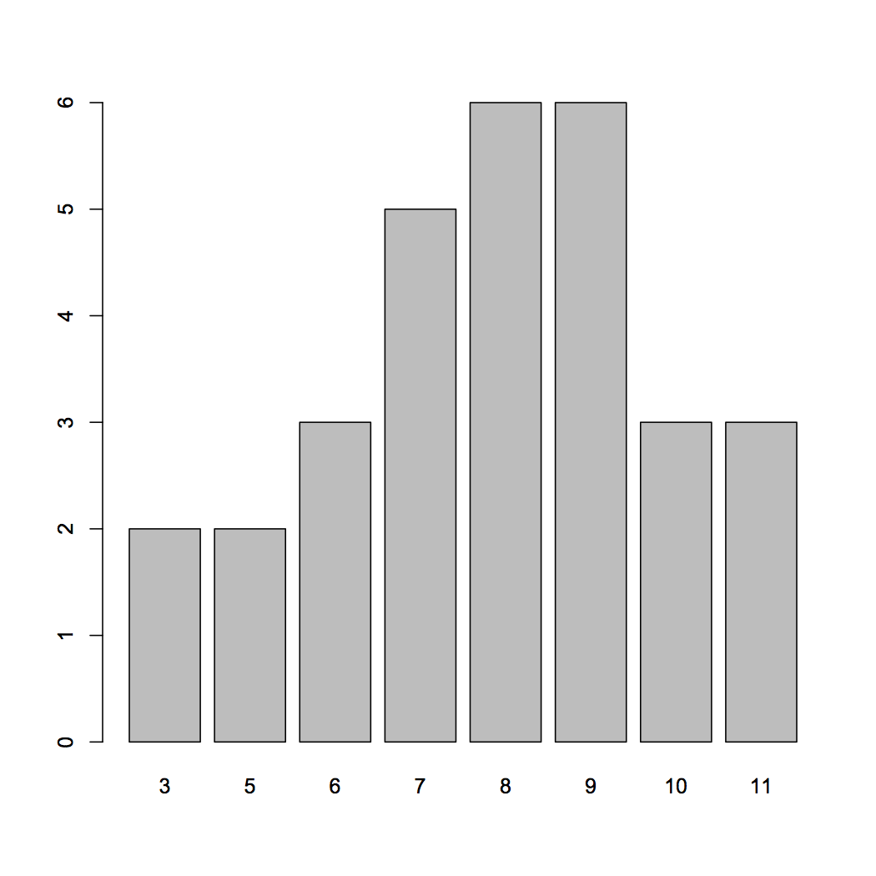
What is the distribution of tails (alternate alleles) do we expect to see after 15 tosses (sequence reads)?
R code:
barplot(table(rbinom(30, 15, 0.5)))
Number of experiments
30 experiments (students tossing coins)
15 tosses each
Probability of Tails
Number of "tails"

Slide 24
What is the distribution of tails (alternate alleles) do we expect to see after 30 tosses (sequence reads)?
Record your result in the following spreadsheet:
https://docs.google.com/spreadsheets/d/1i8sA1KMeYc9UhWTnCg0tLFjCy8x5LlsBITcXrz5La94/edit?usp=sharing

Slide 25
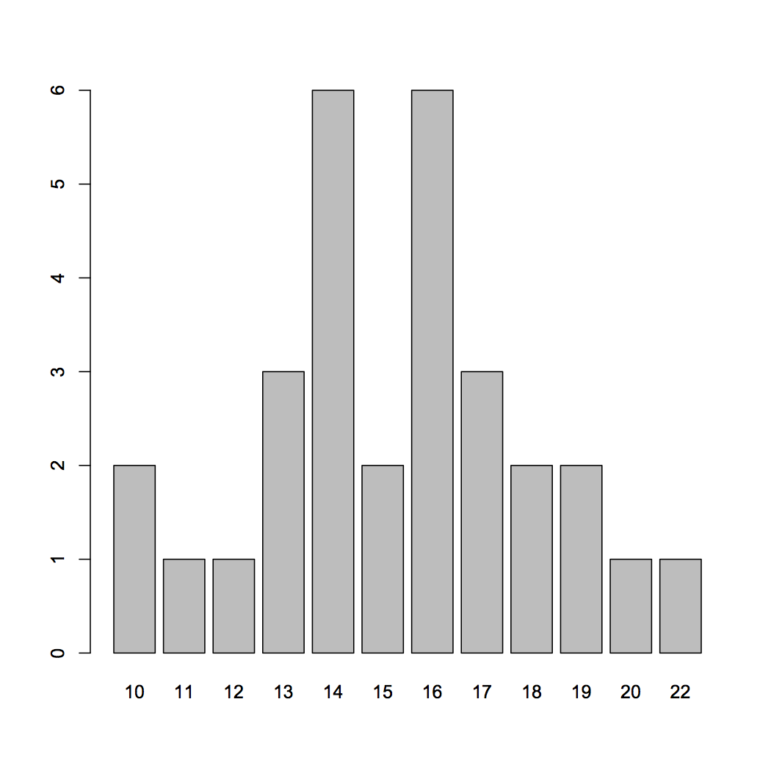
What is the distribution of tails (alternate alleles) do we expect to see after 30 tosses (sequence reads)?
R code:
barplot(table(rbinom(30, 30, 0.5)))
Number of experiments
30 experiments (students tossing coins)
30 tosses each
Probability of Tails
Number of "tails"

Slide 26
So, with 30 tosses (reads), we are much more likely to see an even mix of alternate and reference alleles at a heterozygous locus in a genome
This is why at least a "30X" (30 fold sequence coverage) genome is recommended: it confers sufficient power to find the majority of heterozygous alleles
Number of experiments
Number of "alternate alleles"

Slide 27
Depth tackles the allele sampling issue and lower quality scores
Phred Quality Score of 30
Phred Quality Score of 10
Ref
ATCGGGTACCATCCAATCATTACC
GGTACCATCCAAT
ATCGGGCACCAT
GGGTACCATCCAA
TCGGGcACCATC
CGGGcACCATCC
GGGcACCATCCA
CGGGTACCATCCA

Slide 28
Some real examples of SNPs in IGV

Slide 29
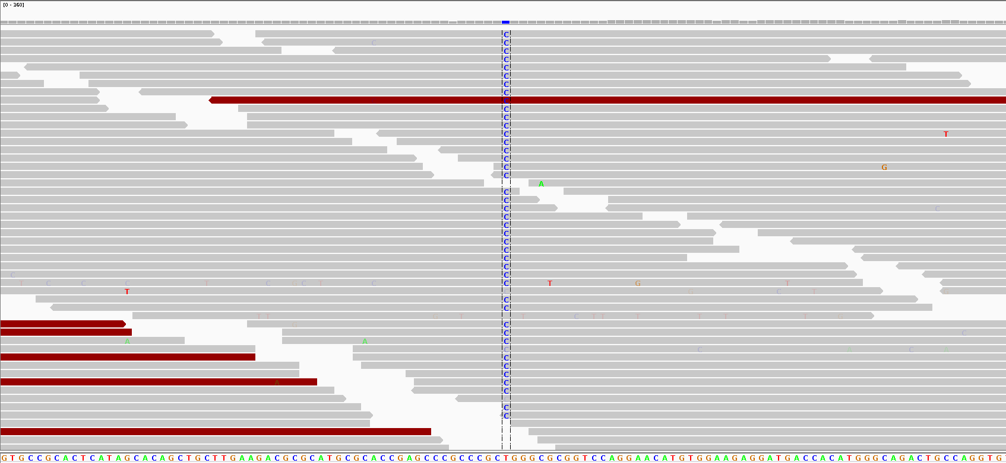
Homozygous for the "C" allele

Slide 30
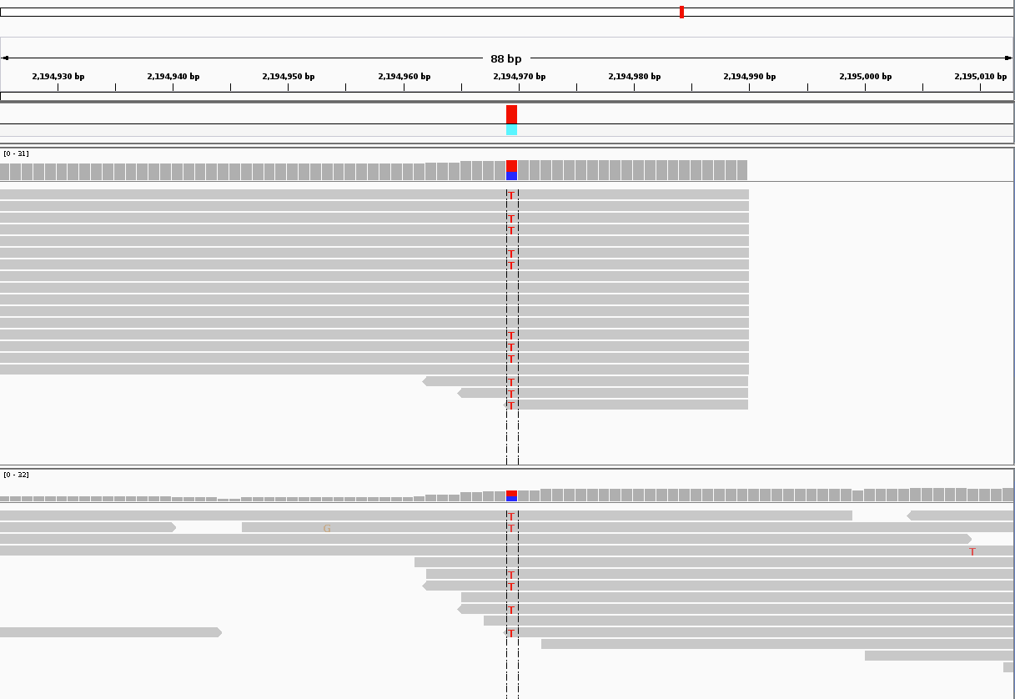
Heterozygous for the alternate allele
Individual 1
Individual 2
Which genotype prediction would you have more confidence in?

Slide 31
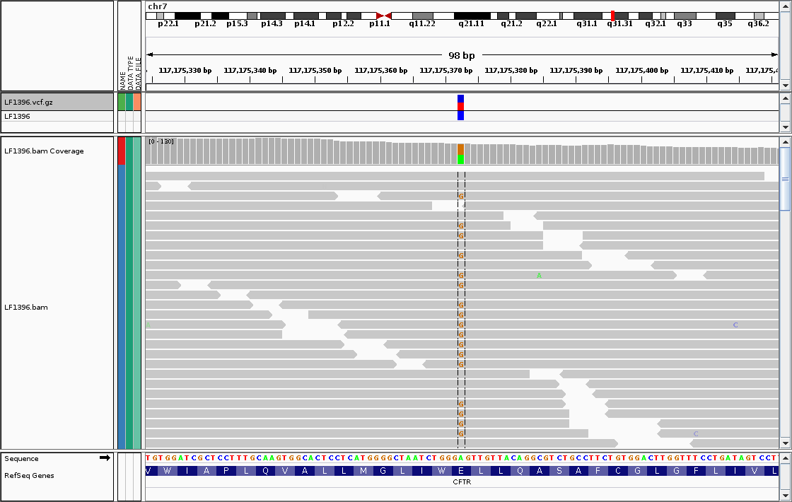
Sequencing errors fall out as noise (most of the time)
Sequencing errors
https://jchoigt.files.wordpress.com/2012/07/igv_e217g_snapshot.png

Slide 32
It is not always so easy

Slide 33
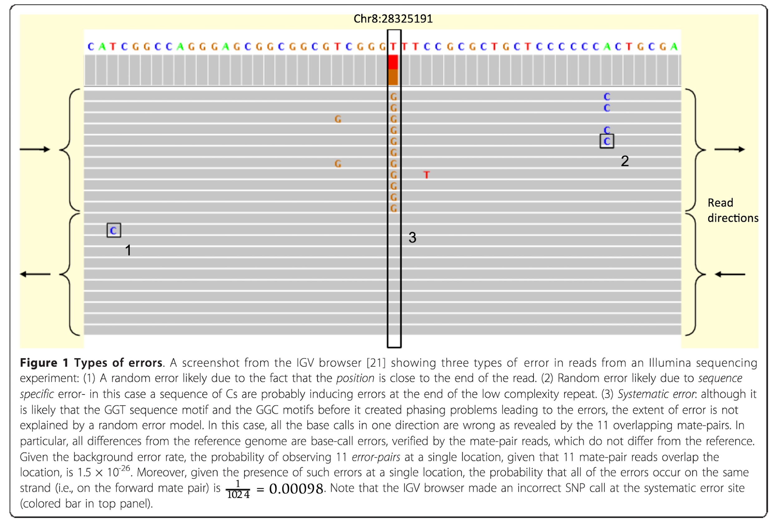
Random versus systematic error
https://www.researchgate.net/publication/51814240_Identification_and_correction_of_systematic_error_in_high-throughput_sequence_data

Slide 34
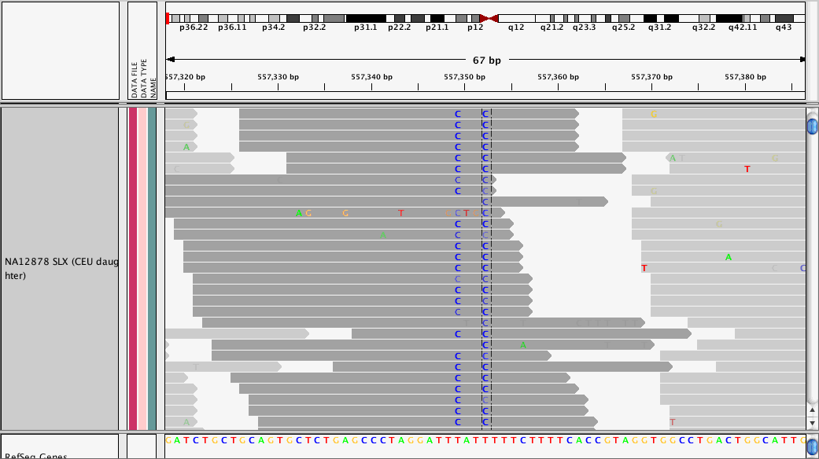
Strand bias from PCR
http://gatkforums.broadinstitute.org/gatk/discussion/49/using-variant-annotator

Slide 35
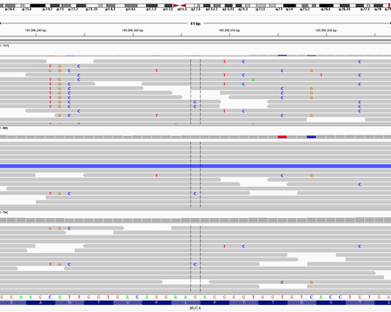

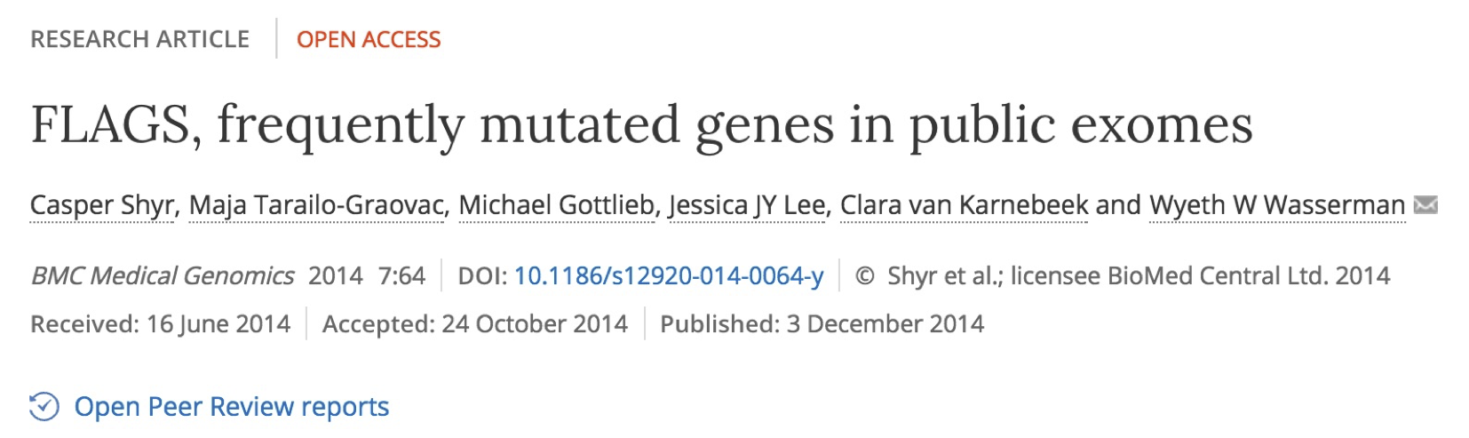
Pileups of many differences from paralogy
http://massgenomics.org/2013/06/ngs-false-positives.html

Slide 36
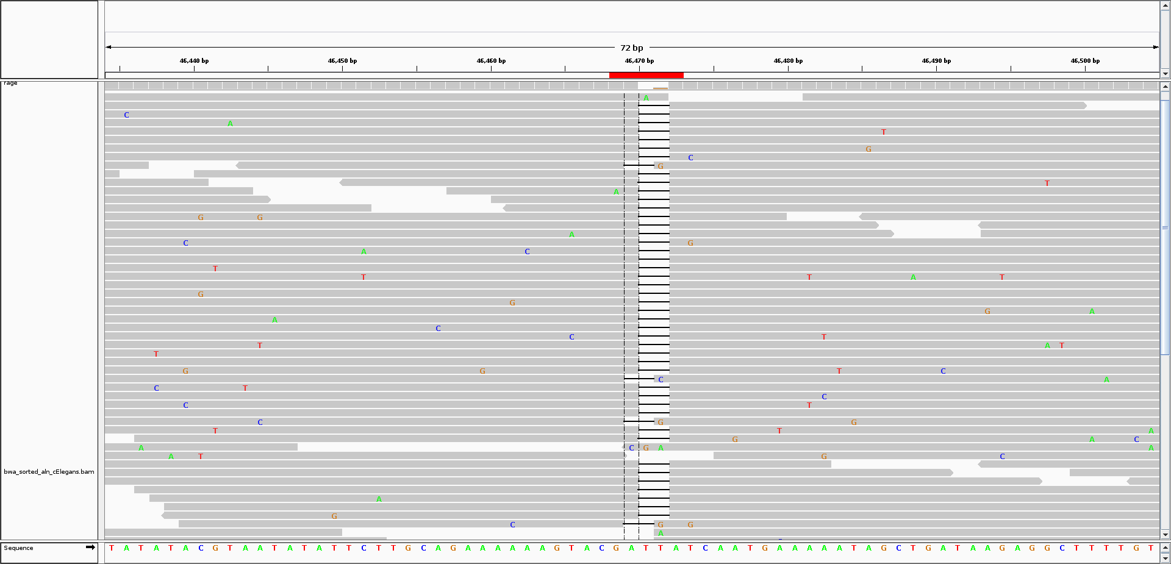
Calling INDELs is _much_ harder than SNPs

Slide 37
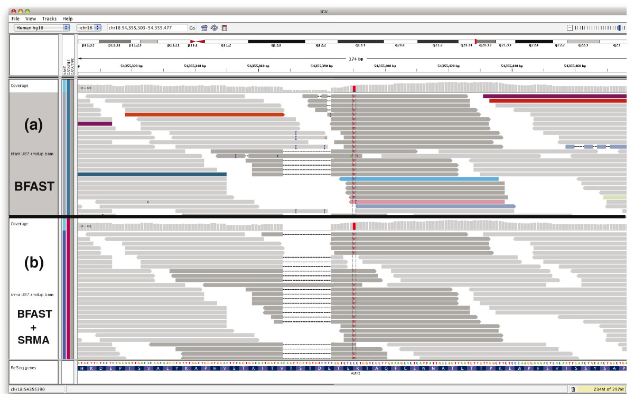
INDEL "realignment"
https://genomebiology.biomedcentral.com/articles/10.1186/gb-2010-11-10-r99

